Slide 1
CSCE 5520:
Wireless Networks and Protocols
1

Slide 2
Ad Hoc Routing
Definition and challenges
Routing:
» Classes: proactive versus reactive routing
» Proactive, table based routing: DSDV
» Reactive routing DSR
» Geographic routing: GPSR
Discussion
Structured as a survey
» But a bit longer since it covers more material
2

Slide 3
Ad Hoc Networking
Goal: Communication between wireless nodes
» No infrastructure – network must be self-configuring
It may require multiple hops to reach a destination
» Nodes are traffic sources, sinks and forwarders
3

Slide 4
Ad Hoc Networking Challenging
All the challenges of wireless, and more:
» Decentralized: nobody is in charge – no planning!
» No fixed infrastructure, random network design
» Generic ad hoc can be arbitrarily bad: limited batteries, malicious nodes, high mobility, low density, ..
Precise challenges depend on the application domain, e.g., vehicular networks versus first- responder networks versus sensor networks
» Domain focus typically simplifies the problem
» Most research papers address the complex general case
The big challenge: Routing
4

Slide 5
Traditional Routing vs Ad Hoc
Traditional wired network:
» Well-structured
» ~O(N) nodes & links
» All links work equally well
» Sensible topology
» Links are independent
Ad Hoc wireless network
» N² links - but many stink!
» Topology may be really weird
» Links interfere with each other
» Dynamic link conditions affect link quality unpredictably
– So the topology also changes constantly!
5

Slide 6
Forwarding Packets is expensive
6

Slide 7
Ad Hoc Routing
Proactive routing: each router maintains a forwarding table listing all destinations
» Uses routing algorithms similar to those in the Internet
» Example: traditional algorithms with wireless metrics
Reactive routing: only find a path when you need it
» Avoids the overhead of periodically executing a routing protocols but can introduce high packet delay
» Example: DSR
Geographic routing: find a path based on geographic coordinates
» Does not require any topology information
» Does not maintain forwarding tables
» Example: GPSR
7

Slide 8
Proactive or Table-based Protocols
Proactive: routers maintain routes independently of the need for communication
» Similar to wired networking – uses forwarding table
Route update messages are sent periodically or when network topology changes
Low latency – forwarding information is always readily available
Bandwidth might get wasted due to periodic updates
8

Slide 9
Reactive or On-Demand Routing
Routers discover a route only when there is data to be sent
Saves energy and bandwidth during periods of inactivity or low activity
Route discovery introduces significant delay for the first packet of a new transfer
Bad if many nodes send packets to many destinations at random times or in unstable networks
10

Slide 10
Ad Hoc Routing
Classes: proactive versus reactive routing
Proactive, table based routing: DSDV
Reactive routing DSR
Geographic routing: GPSR
11

Slide 11
Packet Forwarding versus Routing
Router
1
2
1
3
2
3
5
4
Routing finds a path between two end-points
Forwarding receives a packet and decides which egress port to send it out on
Most networks use a routing protocol to pre- calculate paths between every pair of nodes
» Routers put the result in a forwarding table
Forwarding only requires a lookup in the forwarding table – fast!
Destination Address
Port
IP1 | 1
IP2 | 2
IP3 | 2
IP4 | 2
IP5 | 3
12
Peter A. Steenkiste

Slide 12
Generic Router Architecture
Header Processing
Data Hdr
Queue Packet
Data
Hdr
Lookup IP Address
Update Header
IP Address
Next Hop
1M prefixes
Off-chip DRAM
Address Table
Buffer Memory
Off-chip DRAM
13
13
Peter A. Steenkiste

Slide 13
Traditional Routing Solutions
Link state routing
» Each router obtains a full topology of the network by having nodes periodically flood connectivity information
» Each router then uses Dijkstra’s algorithm to locally calculate its forwarding table
» Bad fit for ad hoc: LS flooding creates a lot of traffic and relies on all routers having a consistent view of network
Distance vector
» Each router tells its neighbors its shortest path to each destination
» Routers then use the “best” option provided to them
» Based on the Bellman-Ford algorithm
» More promising for ad hoc: has lower routing overhead
» Challenge is how to avoid routing loops (details omitted)
Background

Slide 14
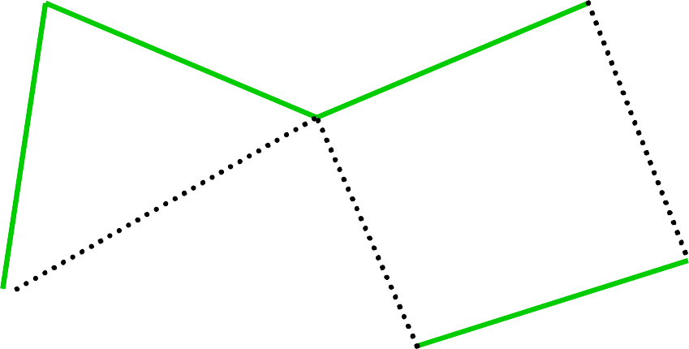
Routes from Node A
Forwarding Table for A
Dest | Cost | Next Hop
A | 0 | A
B | 4 | B
C | 6 | E
D | 7 | B
E | 2 | E
F | 5 | E
E
C
3
1
F
1
2
6
1
3
D
A
4
B
Set of shortest paths forms tree
» Shortest path spanning tree
Solution is not unique
» E.g., A-E-F-C-D also has cost 7
Background

Slide 15
Different View: How to Get to Node C
Forwarding Table for E
Dest | Cost | Next Hop
C | 4 | F
Forwarding Table for F
Dest | Cost | Next Hop
C | 1 | C
Forwarding Table for C
Dest | Cost | Next Hop
C | - | -
E
3
C
1
F
1
2
6
1
3
D
A
4
B
Forwarding Table for A
Dest | Cost | Next Hop
C | 6 | E
Forwarding Table for B
Dest | Cost | Next Hop
C | 2 | F
Forwarding Table for D
Dest | Cost | Next Hop
C | 1 | C
Background

Slide 16
Distance-Vector Method
Initial Table for A
Dest | Cost | Next Hop
A | 0 | A
B | 4 | B
C | ∞ | –
D | ∞ | –
E | 2 | E
F | 6 | F
E
3
C
1
F
1
2
6
1
3
D
A
4
B
Router periodically exchanges tables with neighbors
» Contains the cost and next hop of best known path to all destination
Routers pick the best of the candidates paths
» May be the path it is currently using already
Background

Slide 17
Destination-Sequenced Distance Vector (DSDV)
By Perkins and Bhagvat
DV protocol specifically designed for wireless
» Exchange of routing tables
» Routing table: the way to the destination, plus the cost
Each node advertises its presence and tables
» Maintains fresh routes by periodically sending updates to neighbors
» Update for each destination: hop count, sequence number
Uses sequence number to avoid loops
» Advertisements for each destination include sequence number that is incremented for each update
» Since loops are created by advertisements based on old routing information, they can be detected

Slide 18
DSDV Properties
Keep the simplicity of Distance Vector
Guarantees Loop Freeness
» While adding minimal overhead
Allow fast reaction to topology changes
» Make immediate route advertisement on significant changes in routing table
Drawbacks:
» Overhead can be significant under dynamic conditions and mobility
» Many ad hoc networking scenarios do not require all- all connectivity, so some effort is wasted
Based on: cone.informatik.uni-freiburg.de/teaching/vorlesung/manet-s07/exercises/DSDV.ppt

Slide 19
Overview
Ad hoc networking concept
Proactive versus reactive routing
Proactive, table based routing: DSDV
Reactive routing DSR
Geographic routing: GPSR
Wireless link metrics
Ad hoc networking examples
20

Slide 20
Dynamic Source Routing (DSR) Key Features
On-demand route discovery finds route only when it is needed
» Avoid overhead of periodic route advertisements
Uses source routing: path information is stored in the packet header
DSR control functions:
» Route discovery: senders obtain route to destination
Hop 1
Hop 1
… Dest
» Route maintenance: detect changes in topology and update routes that are affected
» Route caching: nodes cache route information to avoid route discovery for every packet
Caching can be done on sender and intermediate routers
Flush broken routes from cache

Slide 21
DSR Route Discovery
Source broadcasts a route-request towards the destination
» The request includes a (partial) path from source to destination
Each node forwards the request by adding own address to the path and re-broadcasting
Requests propagate outward until:
» The destination is found, or
» A node that has a route to the destination is found

Slide 22
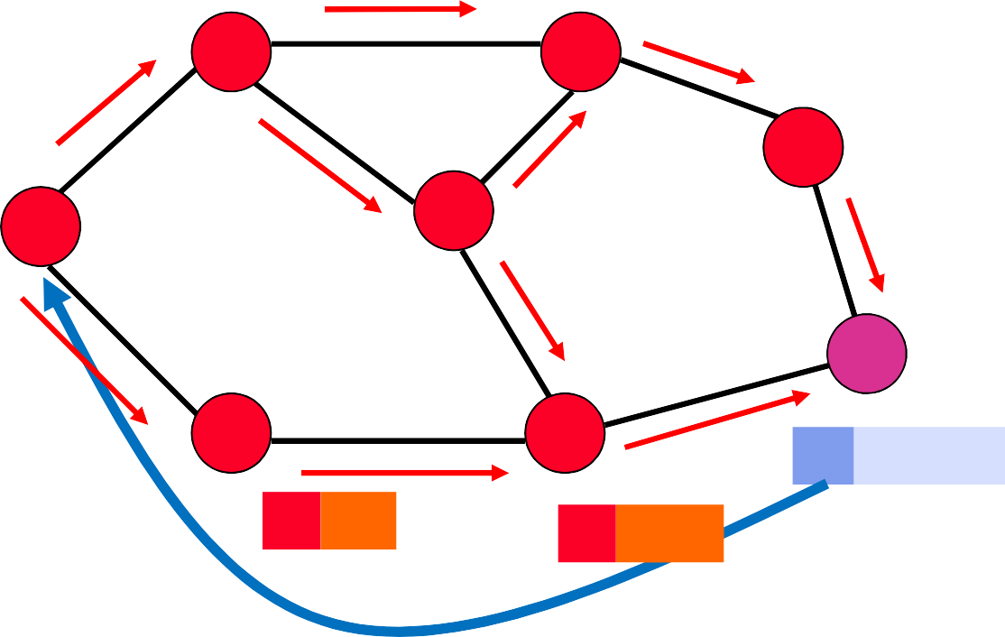
Route Request is Re-Broadcasted until Destination is Reached
A
D
E
Route Request
B
Source C
Destination F
C C,G,H,F
G
F C,G
H
F C,G,H

Slide 23
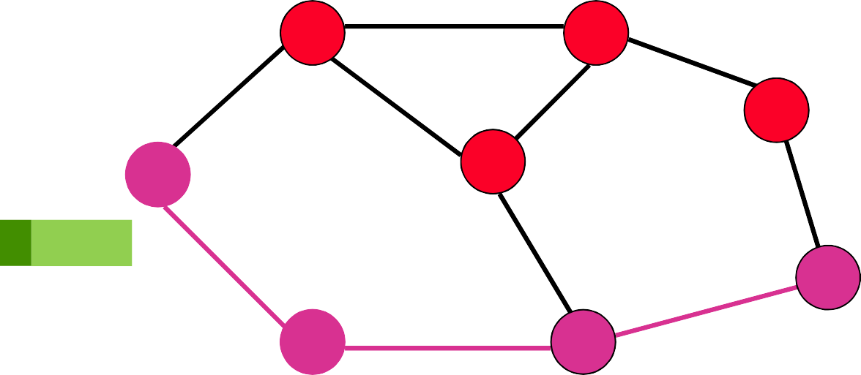
C Transmits a Packet to F
A
D
E
B
Source
C
G,H,F
Destination F
G
H,F
H
F

Slide 24
Forwarding Route Requests
A request is forwarded by a node if:
» Node is not the destination
» Node not already listed in recorded source route
» Node has not seen request with same sequence number
» IP TTL field may be used to limit scope
Destination copies selected route into a Route-reply packet and sends it back to Source
» I.e., route reply uses reverse path of the route selected by the destination
» Destination can choose one of the paths, e.g., first path (with shortest delay)

Slide 25
Route Cache
All source routes learned by a node are kept in a Route Cache
» Routes are learned by overhearing route requests/responses
» Reduces cost of route discovery
If an intermediate node receives a route request for a destination and has an entry for the destination in its route cache, it
» Responds to the request using the cached information
» Does not propagate the request any further
Nodes use their local route cache when asked to send a data packet
» If route is missing, they initiate a route request

Slide 26
Basic Route Maintenance
A
B
C
D
E
When forwarding a packet, each sender must get an acknowledgement from the next hop
» Will retransmit the packet up to a limit if needed
If no ACK is received it drops the packet and notifies the sender A of the broken link
A removes the route from its route cache and ..
» Intermediate nodes also remove any cached entries to E
Will do a new route discovery when it sends another packet to E
» It is left up to TCP to recover from the packet loss

Slide 27
Discussion
Source routing is good for certain types of networks and traffic loads
» For example, stable traffic flows and/or a small number of sender-receiver pairs
» Stable network topologies, e.g., with limited mobility
Periodic messages are avoided
Significant delay for the first packet to a destination
» Also, need to buffer packets

Slide 28
Overview
Ad hoc networking concept
Proactive versus reactive routing
Proactive, table based routing: DSDV
Reactive routing DSR
Geographic routing: GPSR
Wireless link metrics
Ad hoc networking examples

Slide 29
Greedy Perimeter Stateless Routing (GPSR)
Use positions of neighboring nodes and packet destination to forward packets
No connectivity or global topology is assumed
– no forwarding or path information anywhere!
Nodes are assumed to know their location
Need a mechanism for address-to-location look up
Two forwarding techniques is used
Greedy forwarding, if possible
Perimeter forwarding, otherwise
30

Slide 30


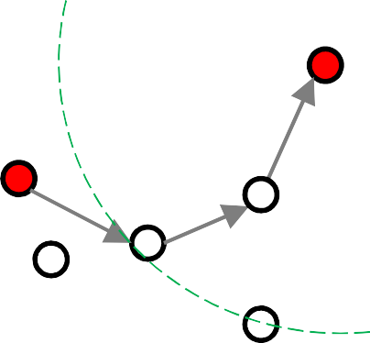


GPSR – Greedy forwarding
A sender/forwarder x chooses to forward to a neighbor y such that {d_{xy} + d_{yD}} is minimum
D
x
y
31

Slide 31
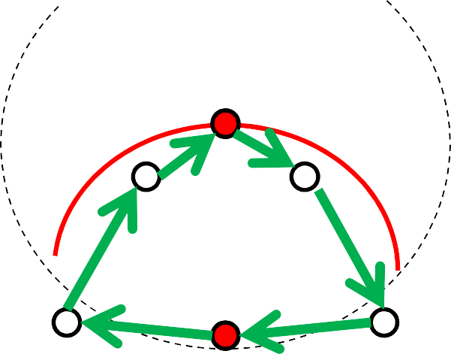
GPSR – Perimeter forwarding
What happens if a node does not have a neighbor that is closer to the destination?
Right Hand Rule: you forward the packet to your first neighbor clockwise around yourself
Traverse an interior region in clockwise edge order
Guaranteed to reach a (reachable) destination for planar graph
This sequence of edges traversed is called a PERIMETER
D
v
z
VOID
x
w
y
32
Peter A. Steenkiste

Slide 32
Discussion
Many variants:
» Hybrid approaches mix different solutions
» Hierarchical: create a hierarchy of clusters
Many proposals for optimizations
» Links use different frequencies, multiple radios, etc.
» Link metrics that consider interference level, …
Best solutions is highly context dependent: density, traffic load, degree of mobility, …
Practical applications are rare by exist:
» Mesh networking: wireless, last mile Internet access
» Challenging conditions: first responders, military, ..
» In the future maybe vehicular, drones, …

Slide 33
Summary
Ad hoc networks face many challenges
» Bad links, interference, mobility, …
» Makes routing very challenging
» Limited support: hardware and driver limitations
Many proposals!
» Proactive routing: variants of “wired” routing protocols
» Reactive routing: only establish a path when it is needed
» Geographic routing: use destination location info only
» Many variants and extensions
Specific challenges depend on the application domains
» Mesh versus vehicular
» Active area of research

Slide 34
Some References
DSR:
» www.cs.rice.edu/~dbj/pubs/aw-dsr.pdf
DSDV:
» www.cs.jhu.edu/~cs647/class-papers/Routing/p234-perkins.pdf
GPSR:
» www.eecs.harvard.edu/~htk/publication/2000-mobi-karp-kung.pdf
ETX:
» pdos.csail.mit.edu/papers/grid:mobicom03/paper.pdf
ETT
» http://www.cs.jhu.edu/~cs647/class-papers/Routing/p114-draves.pdf

